Slide 1




PyTorchSim: A Comprehensive, Fast, and Accurate NPU Simulation Framework
MICRO 2025 Session 7B: Tools and Simulators
Wonhyuk Yang∗, Yunseon Shin∗, Okkyun Woo∗, Geonwoo Park§, Hyunkyu Ham,
Jeehoon Kang†¶, Jongse Park¶, Gwangsun Kim
POSTECH
Parallel System Architecture Lab.
∥ † FuriosaAI
¶ KAIST
* Equal contribution
§ Currently with Samsung Electronics
Notes:
Thank you for the kind introduction.
Let’s get started
(5 Sec)

Slide 2
AI Model & Hardware Trends
Deep Neural Network (DNN) are growing exponentially in size
Hardware performance improves relatively slowly
10²⁹
10¹⁷
10²⁶
10²³
10¹⁶
4.4x / year
10²⁰
10¹⁵
1.4x / year
10¹⁷
10¹⁴
10¹⁴
10¹¹
10¹³
We need high-performance & efficient hardware
Notes:
Modern Deep Neural Networks are growing exponentially in size.
(click) The required training compute for DNN models grows by (click) about 4 times per year.
(click) Meanwhile, hardware performance is also improving,
(click) but at a much slower rate of only 1.4 times per year.
(click) And this gap creates a strong demand for high-performance, efficient hardware.
(click)

Slide 3

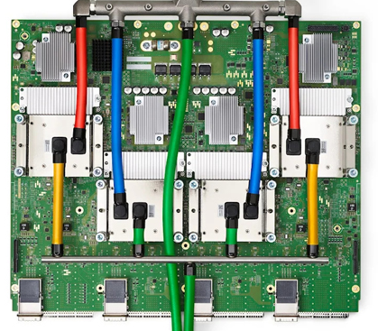
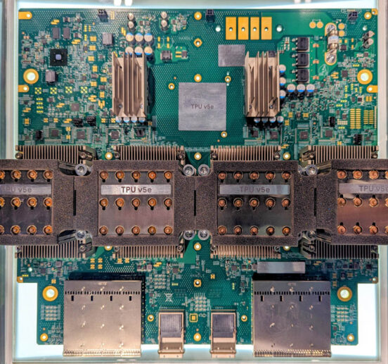
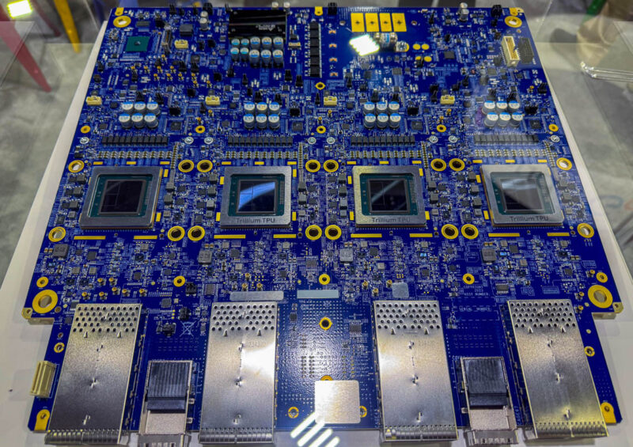
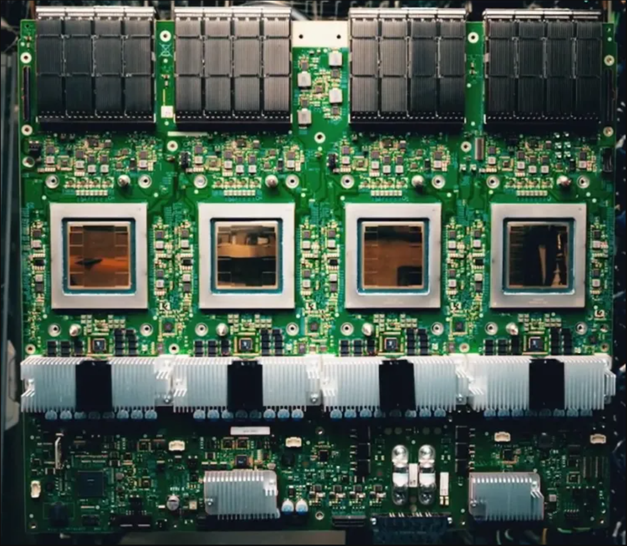
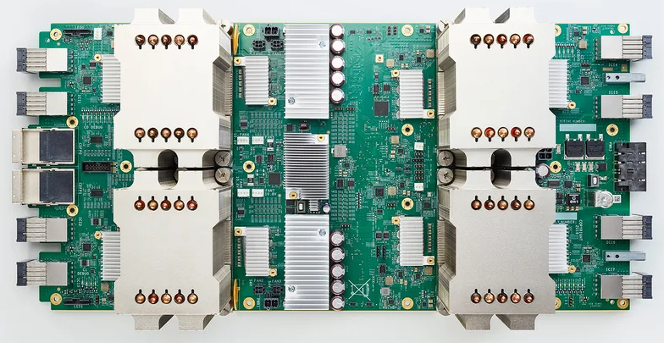
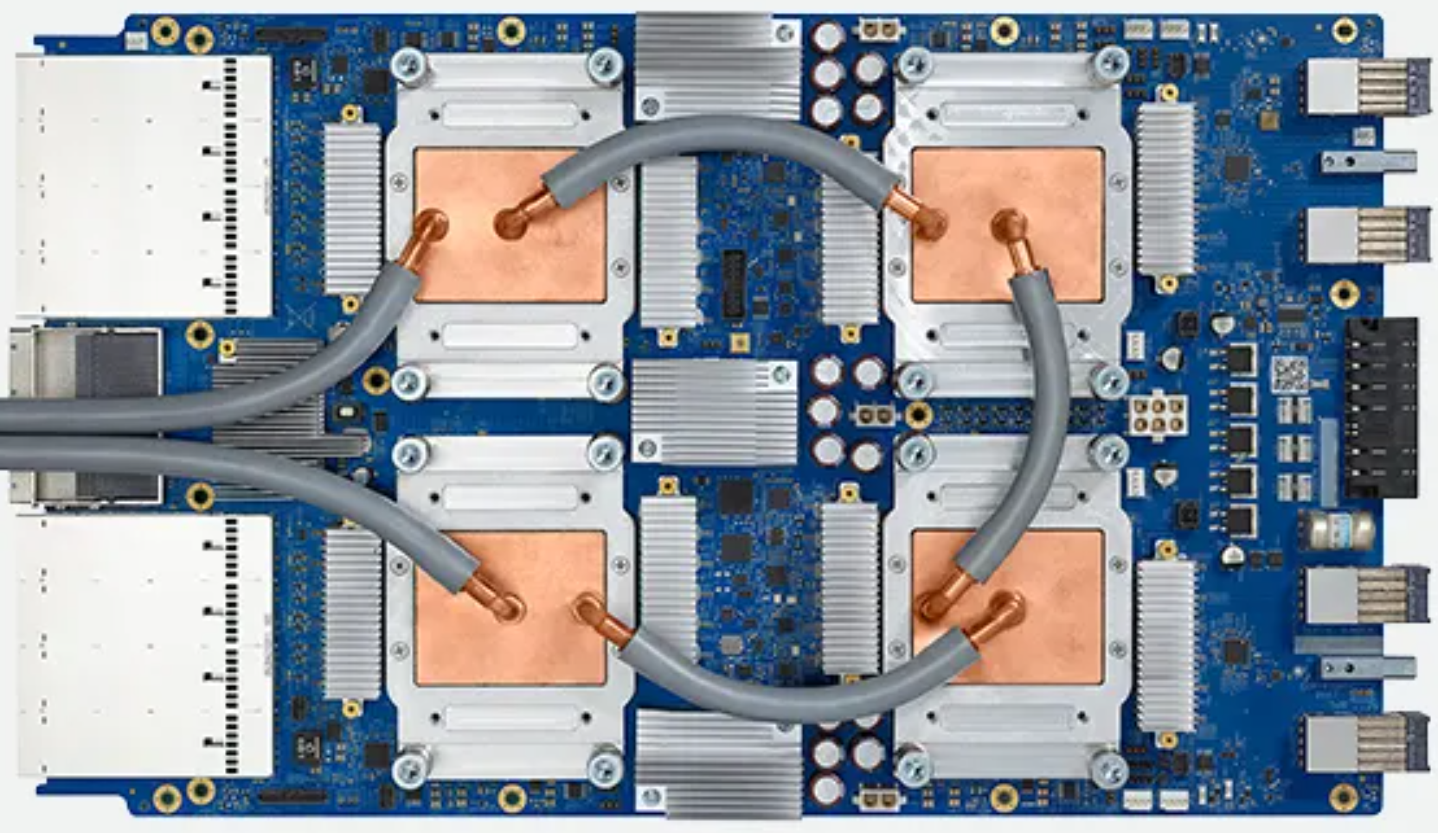
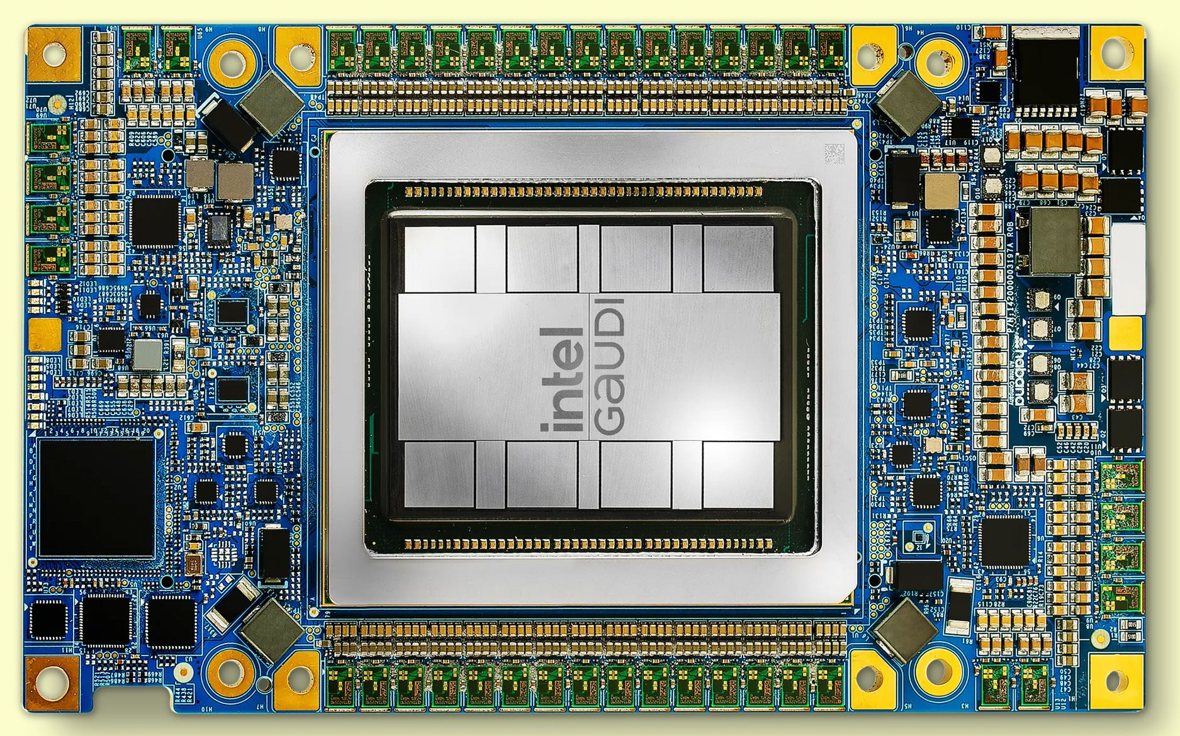

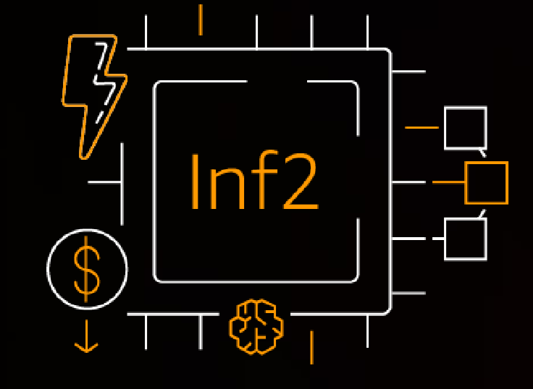
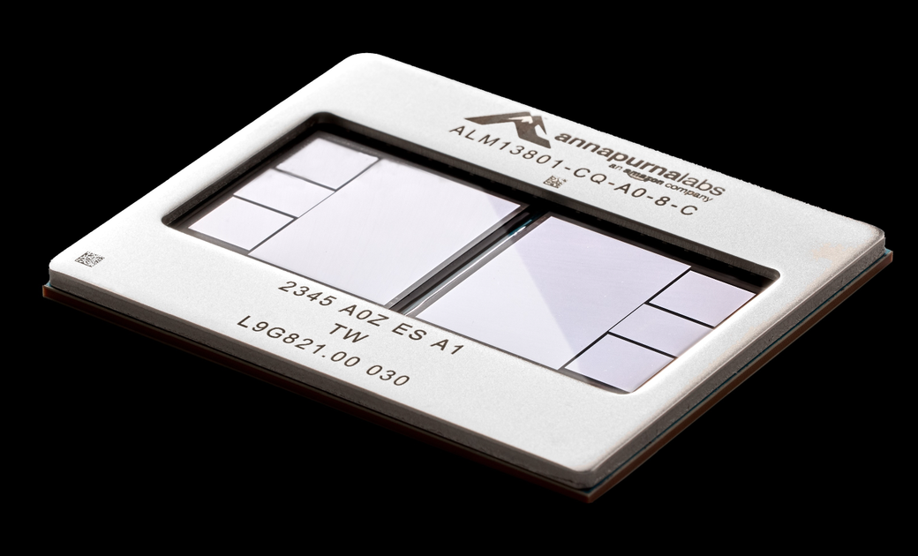

Evolution of Neural Processing Units
Neural Processing Units (NPUs) are designed to address this challenge
Efficient dataflow units (e.g., systolic arrays, adder-tree)
TPU v2
TPU v3
TPU v4
TPU v5
TPU v6
TPU v7
Future NPUs
?
Inferentia2
Trainium2
Intel Gaudi3
NPU simulators play a crucial role in designing NPUs
Notes:
To meet this demand, many companies are designing custom accelerators called Neural Processing Units, or NPUs.
(click) Notably, the NPUs utilize dataflow units, such as systolic arrays, for high-performance tensor operations.
To address the challenging demands from AI models,
(click) the NPUs are also continually evolving for higher performance.
(click) However, in architecting NPUs, simulators are necessary to evaluate new design ideas before implementing them in RTL level.

Slide 4
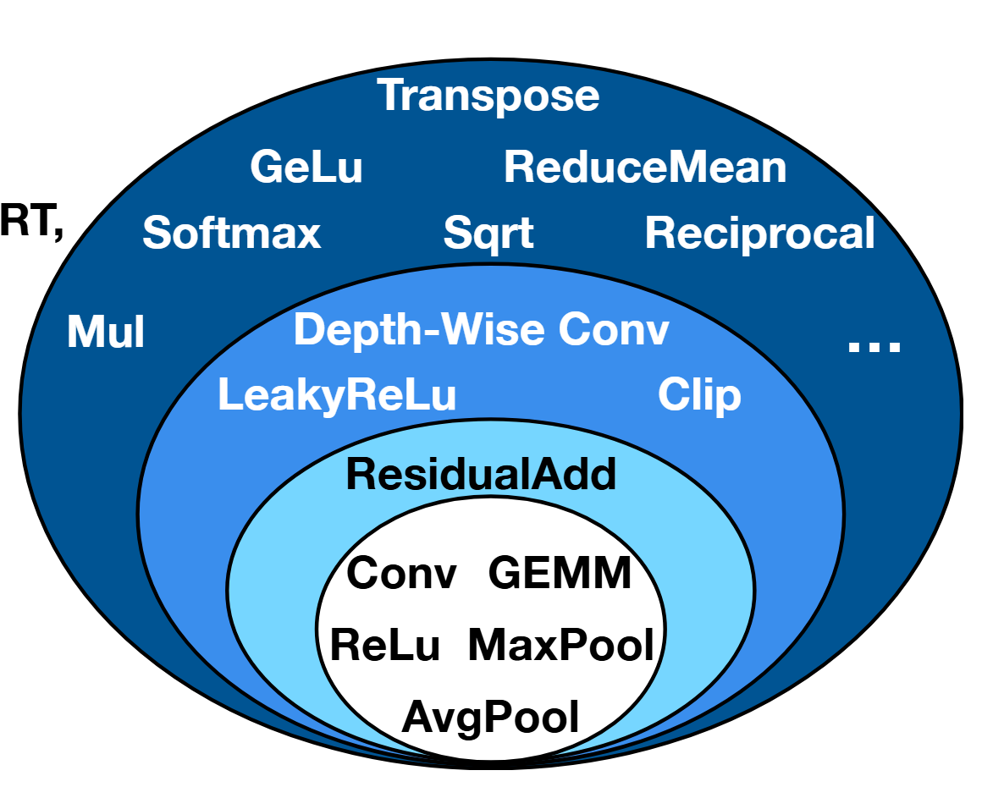
NPU Simulator Requirements – AI Model
Both inference and training are important
(Vector) operations are becoming increasingly diverse
Sparsity is now widely exploited for efficiency
  Latency varies with input data (i.e., data-dependent timing behavior)
Mixture-of-Expert
Inferentia2
(Inference)
Trainium2
(Training)
FFN 1
FFN 2
FFN 3
Router
Source: Tandem Processor
[Ghodrati, Soroush, et al,. ASPLOS 2024]
Notes:
For proper NPU performance evaluation, the simulator should consider three aspects.
First, from the AI model perspective,
(click) the simulator must support both inference and training, as they are both important.
(click) Also, modern AI models use an increasingly diverse set of operations, beyond simple GEMM and convolution.
(click) Furthermore, sparsity is now widely exploited for efficiency as in mixture of experts. Such AI models exhibit data-dependent performance behavior.
(click)

Slide 5
NPU Simulator Requirements – NPU Hardware
Need to accurately model key components of modern NPUs
NPU core: matrix, vector, and scalar units and scratchpad memory
Shared resources: interconnect and DRAM
  Detailed simulation often necessary to model inter-core contention
NPU Core 0
Matrix multiply unit
Vector
unit
Scalar
unit
NPU Core 1
DMA engine
Scratchpad memory
Memory controller
Interconnect
Memory controller
Notes:
Second, from the hardware perspective,
(click) It's crucial to accurately model the key components of modern NPUs.
(click) This includes the NPU core itself, with its matrix, vector, and scalar units, and scratchpad memory.
(click) In addition, contention for shared resources like the interconnect and DRAM needs to be accurately modeled.

Slide 6
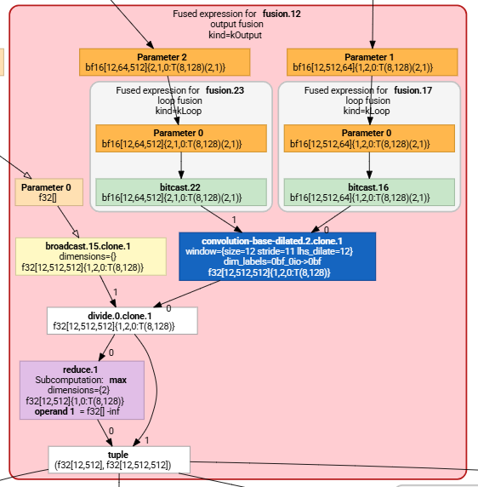
NPU Simulator Requirements – Compiler
Necessary to bridge AI models and NPU hardware
Lowers DNN models into machine code
Apply various optimizations
Enables full-model simulation for both inference and training
PyTorch models
Operation fusion
PyTorch
compiler
GEMM
TorchDynamo/
Autograd
TorchInductor
    For compiler support, an NPU ISA must first be defined
GPU backend
CPU backend
Vector
Target machine code
Notes:
Finally, compiler support
(click) is necessary to bridge AI models and the NPU hardware.
(click) It's responsible for lowering the DNN model into machine code,
(click) and it applies various optimizations during this process.
(click) For training, it also performs auto-differentiation for the backward pass.
(click) But to enable compiler support, an NPU ISA must first be defined.

Slide 7

NPU ISA
No de-facto standard ISA for NPUs (unlike CPUs and GPUs)
RISC-V can be a strong candidate for an NPU ISA
  Generality:
    Vector-length agnostic design
    A generic interface (VCIX) for dataflow units
  Extensibility: Reserved opcode space for custom instructions
  Openness: Contributions from both academia and industry
  SW Infrastructure: Rich software ecosystem (e.g., compilers, simulators)
Notes:
(click) However, unlike CPUs and GPUs, there is no de-facto standard ISA for NPUs.
(click) We believe that RISC-V can be a strong candidate for an NPU model’s ISA
(click) It has a flexible vector-length-agnostic design and enables a generic interface for attaching custom dataflow units.
(click) It has reserved opcode space, which lets us add custom instructions for NPU-specific tasks.
(click) Thanks to its openness, it is freely available for both academia and industry
(click) It also features a rich open-source software Infrastructure, including compilers and simulators. No other open ISA has comparable momentum for ecosystem growth.
(click)

Slide 8
Existing NPU Models
Various NPU simulators and analytical models have been proposed
Timeline
None of them meets all the key requirements
SMAUG, MAESTRO
2019
  Full AI model support
Timeloop
❌
2020
Stonne
  AI compiler support
2021
❌
2022
mNPUSim, Sparseloop
  NPU core & shared resources
2023
We propose PyTorchSim, which can better satisfy the key requirements for NPU simulation
GeneSys
2024
Scale-Sim v3
  Fast & accurate simulation
2025
Notes:
Over the years, various NPU simulators and analytical models have been proposed,
(click) However, none of them meet all the key requirements we just discussed.
To fill this gap, (click) we propose PyTorchSim, which can better satisfy the key requirements for NPU simulation
Simu’lation
4분

Slide 9
Contents
Background / Motivation
PyTorchSim
  PyTorchSim overview
  NPU core modeling
  Compilation flow
Methodology & Evaluation
Case study
  Impact of DNN Training Hyperparameter
  Scheduling for Chiplet-based NPUs
Summary
Notes:
The remainder of this talk will cover the design of PyTorchSim framework[↗], its accuracy and simulation speed evaluation[↗], and two examples of case studies which are uniquely supported by PyTorchSim.
(click)

Slide 10
PyTorchSim Framework: Overview
PyTorch AI model
Runs PyTorch models directly
PyTorch 2.x
NPU Backend
Compiles the models to a RISC-V based NPU ISA
General and extensible architecture
Fast & accurate simulation
NPU Simulator
Notes:
At a high level,
(click) PyTorchSim takes existing PyTorch models and runs the code directly, unlike existing simulators that often require manual model descriptions.
(click) Next, our Pytorch NPU Backend com’piles the model to a RISC-V based NPU ISA.
(click) Finally, the com’piled binary is executed on our NPU simulator, which provides general and extensible architecture modeling and fast and accurate simulation.
(click)

Slide 11
Modeling Common Building Blocks in NPU Cores
Extensible NPU core
Extensible NPU ISA
Scalar unit
Vector unit
DMA engine
SFU.
Dataflow unit
DMA engine
Scalar
unit
Special function unit
RISC-V +
Vector extension
VCIX
Scratchpad memory
Vector
unit
Dataflow unit (e.g., systolic array)
Custom
Instructions
Notes:
Our simulator can model NPU cores with common components and extensible interface.
(click) For data movement, we model a DMA engine and an on-chip scratchpad memory
(click) For general operation support, the core includes a scalar unit and a vector unit.
(click) It also integrates dataflow units like systolic array for matrix multiply, as well as a special function unit for custom operations
(click) These components execute the instructions in our Extensible NPU ISA based on a customized RISC-V with vector extension.
(click) Especially, to control the dataflow and special function units, we adopt a generic interface called Vector Coprocessor Interface eXtension or VCIX.
(click)

Slide 12

VCIX: A Generic Interface for Dataflow Units
Vector unit
Serializer
(input)
Dataflow unit
(e.g., Systolic array)
SiFive
Serializer
(weight)
VCIX
Deserializer
(output)
We adopt VCIX, a generic interface for diverse dataflow units
Notes:
Sifive’s VCIX provides an interface between the vector unit and dataflow unit as well as its supporting instructions.
(click) It has two serializers and a deserializer to transfer input, weight, and output between them.
(click) Thus, vcix’s generic interface enables us to model diverse dataflow units, including systolic arrays and other dataflow.
(click)

Slide 13


PyTorchSim Compilation Flow
PyTorch models
Benefits of integration with PyTorch 2
  Simulate existing PyTorch models without any need for manual conversion
  Supports training simulation through
  PyTorch’s auto-differentiation
  Leverage existing target-independent optimizations
torch.compile()
TorchDynamo/Autograd
FX graphs
TorchInductor
Loop-level IR
NPU backend
(Ours)
MLIR
LLVM
GPU backend
CPU backend
NPU backend generates a RISC-V binary
  Applies target-dependent optimizations
PyTorch 2 compiler
RISC-V
binary
Notes:
We use the NPU model as the target for our c’ompi’lation flow.
(click) We implement an NPU backend integrated into pytorch 2 com’piler for several benefits.
(click) First, we enable simulation of existing PyTorch models, without any need for manual conversion.
(click) Second, we can support training simulation through PyTorch's auto-differentiation.
(click) Finally, we can leverage existing target-independent optimizations.
(click) The NPU backend com’piles the model into a RISC-V binary using MLIR and LLVM.
During this process, target dependent optimizations are applied.
(click)

Slide 14
Instruction-Level Simulation (ILS)
RISC-V binary (GEMM)
DMA load
Tile A
.insn r 43, 3, 0, zero, t2, t4
.insn r 43, 3, 4, zero, a2, ra
.insn r 43, 3, 5, zero, a2, s8
.insn r 43, 3, 2, zero, a3, s0
add a0, s1, a6
.insn r 43, 3, 0, zero, a7, t4
.insn r 43, 3, 4, zero, a2, ra
.insn r 43, 3, 5, zero, a2, s8
.insn r 43, 3, 2, zero, a0, a5
addi a4, a4, 1
addi s1, s1, 512
addi a5, a5, 1024
bge s3, a4, .LBB0_16
j .LBB0_13
...
add a0, a0, s7
vmv1r.v v11, v6
vle32.v v11, (a0), v0.t
sf.vc.iv 1, 0, v8, 0
sf.vc.iv 1, 0, v9, 0
...
sf.vc.iv 1, 0, v8, 0
sf.vc.iv 1, 0, v9, 0
li s11, 136
bltz s3, .LBB0_21
Simulate every single instruction one-by-one
Inherently slow
DMA load
Tile B
GEMM
B MATRIX
RISC-V
binary
Tile B
A MATRIX
C MATRIX
NPU Simulator
Matrix multiply
Tile A
Tile C
(~100 instructions)
Notes:
(click) This binary is then executed by the NPU Simulator in the basic approach. We call (pause) this simulation method Instruction-Level Simulation or ILS,
However, ILS has a significant limitation. it simulates every single in’struction one by one.
(click) As a result, ILS is inherently slow.
(click) Here is an example GEMM operation (click) and its com’piled binary.
This binary is composed of instructions for (click) DMA and (click) matrix multiplication.
(click) This single matrix multiply operation for one tile is com’piled down to hundreds of instructions.
Thus, executing them individually can be slow.
(click)

Slide 15
Key Insight behind NPU Execution
NPU Core
NPU Core
Compute units
Compute units
Intra-core compute latency is deterministic
Scratchpad memory
Scratchpad memory
Interconnect
NoC & DRAM latencies remain
non-deterministic due to
inter-core contention and traffic
Memory ctrl.
···
Memoryctrl.
DRAM
···
DRAM
Notes:
To overcome this, we exploit a key insight behind NPU Execution
(click) typical NPUs use scratchpad memory in the core and data movements are explicitly managed before and after computation.
(click) Thus, once the data are fetched from DRAM to the the scratchpad memory,
(click) the intra-core compute latency is deterministic.
(click) However, the NoC and DRAM latencies for accessing off-chip memory remain non-deterministic, because they can vary due to inter-core contention and traffic.
(click)

Slide 16
Tile Operation Graph (TOG)
RISC-V binary (GEMM)
DMA load
.insn r 43, 3, 0, zero, t2, t4
.insn r 43, 3, 4, zero, a2, ra
.insn r 43, 3, 5, zero, a2, s8
.insn r 43, 3, 2, zero, a3, s0
add a0, s1, a6
.insn r 43, 3, 0, zero, a7, t4
.insn r 43, 3, 4, zero, a2, ra
.insn r 43, 3, 5, zero, a2, s8
.insn r 43, 3, 2, zero, a0, a5
addi a4, a4, 1
addi s1, s1, 512
addi a5, a5, 1024
bge s3, a4, .LBB0_16
j .LBB0_13
...
add a0, a0, s7
vmv1r.v v11, v6
vle32.v v11, (a0), v0.t
sf.vc.iv 1, 0, v8, 0
sf.vc.iv 1, 0, v9, 0
...
sf.vc.iv 1, 0, v8, 0
sf.vc.iv 1, 0, v9, 0
bltz s3, .LBB0_21
Tile Operation Graph (TOG)
Loop Start
DMA load
DMA
Load Tile A
DMA
Load Tile B
Matrix Multiply
( X cycles )
Condition
Matrix multiply
(~100 instructions)
DMA
Store Tile C
Notes:
Based on this insight, (click) we propose Tile Operation Graph, or TOG, as a higher-level representation of the machine code.
(click) Instead of individual instructions, the nodes in this graph represent coarse-grained operations for a single tile, like DMA nodes and compute nodes.
(click) In particular, the compute node can include the deterministic tile compute latency.
(click)

Slide 17
Tile-Level Simulation (TLS) Execution Flow
Tile-Level Simulation works in a two-step flow
Offline (compile time)
Obtain the deterministic compute latency in the TOG
Online (simulation time)
Reuse the obtained compute latency
Model DMAs with detailed NoC & DRAM
simulators (bookism, ramulator2)
Tile Operation Graph (TOG)
Loop Start
DMA
Load Tile A
DMA
Load Tile B
Matrix Multiply
(x cycles)
Offline
Condition
TLS can achieve both high simulation speed and accuracy
Online
DMA
Store Tile C
Notes:
Exploiting TOG, we introduce our novel simulation method called tile-level simulaton or TLS.
(click) TLS has two phases: offline and online.
(click)
The Offline phase happens once, at compile time.
Here, we run a timing simulator to get the deterministic compute latency for each compute operation in the TOG.
(click)
The Online phase runs the actual simulation.
During this phase, the simulator reuses obtained compute latencies from the TOG, while modeling DMAs using detailed NoC & DRAM simulators to model contention.
(click)
As a result, TLS can achieve both high speed and high accuracy
(click)

Slide 18

PyTorchSim TLS Compilation Flow
Loop-level IR
PyTorch
Runtime
NPU backend
(Ours)
TOG Simulator
(TLS)
TOG
Lowering pass
RISC-V
binary
Compute
latency
MLIR
LLVM
Gem5 (timing simulator) models the compute latency for TLS
Challenge: Tile operation latency can depend on input data!
Notes:
The Tile-level simulation is supported by further extending our NPU compiler backend.
(click) During the lowering pass, the compiler generates both the TOG and the RISC-V binary.
(click) Then We execute the RISC-V binary on gem5 to obtain deterministic compute latencies, which are written to the TOG.
(click) After that, the tog is passed to our TOG simulator.
(click) However, in some cases, tile operation latency can depend on the input data.
(click)

Slide 19


Data-Dependent Timing Behavior Example
SpMspM TOG
Sparse matrix multiply unit
Loop Start
Tile
B₀
Tile
B₁
Tile
B_{k-1}
…
DMA
Load Tile A
DMA
Load Tile B
Tile
A₀
Tile
C₀
Tile
A₁
Tile
C₁
Tile
A_{k-1}
Tile
C_{k-1}
Matrix Multiply
Condition
Data-dependent attributes
Latency X₀
$$≠$$
Latency X₁
$$≠$$
Latency X_{k-1}
DMA
Store Tile C
For each specific pair of input tiles,
the compute latency is still deterministic
Notes:
For example, in sparse matrix multiplication, (click) the execution latency depends on the number of non-zero elements in the input tiles.
However, we make a key observation that,
(click) for each specific pair of input tiles, the compute latency is still deterministic.
Thus, we obtain the data-dependent latencies for each input pair offline and reuse them during simulation.
(click) We refer to this information as data-dependent attributes.

Slide 20

PyTorchSim TLS Compilation Flow
Loop-level IR
PyTorch
Runtime
TOG
TOG Simulator
Lowering pass
RISC-V
binary
Compute
latency
MLIR
LLVM
Input tensors
Spike
Data-dependent attributes
Output tensors
Spike (functional simulator) executes the binary with PyTorch input:
  To obtain data-dependent attributes
  To validate correctness of compiled binary
Notes:
When latencies are data-dependent,
(click) we obtain the attributes using the functional simulator(spike) with inputs. Then, TOGsim uses the attributes along with the TOG.
(click) Additionally, we can also validate the correctness of com’piled binary by checking the outputs from Spike.
(click)

Slide 21
Putting It All Together
PyTorchSim Framework
NPU Backend
PyTorch Runtime
TOG Simulator
Lowering pass
TOG
NPU
core
Mem. ctrl.
DRAM
RISC-V
binary
Compute
latencies
MLIR
LLVM
···
···
PyTorch
models
···
Interconnect
Input tensor
NPU
core
Mem. ctrl.
DRAM
Data-
dependent
attributes
Data-dep.
attributes
Spike
Output tensor
Notes:
Putting it all together,
(click) Our NPU backend compiles PyTorch model into a binary and a TOG, for RISC-V-based extensible NPU.
(click) Then, from the binary, Gem5 and Spike are used to obtain compute latencies and data-dependent attributes.
(click) Finally, our TOGSim uses them for fast and accurate simulation.

Slide 22
Evaluation Methodology
Accuracy validation
Target: Real Google TPU v3
Baselines: SCALE-Sim v3, mNPUSim, Timeloop, MAESTRO
Simulation speed
Baselines: Accel-Sim, mNPUsim
  We selected Accel-Sim for its rich features and GPUs’ dominance in deep learning
Workloads
Kernels: GEMM, convolution, layer normalization, softmax, attention
Full models: ResNet18/50, Bert-base/large
 | Cores & clock | Systolic arrays | Vector lanes (# of ALUs) | Scratchpad | DRAM
TPU v3 | 1 core @ 940 MHz | (128x128) x 2 | 128 (16 ALUs each) | 32 MB | 4 HBM2 (960 GB/s)
Notes:
For accuracy evaluation, we use a real Google TPU v3 as target,
(click) and compare the accuracy of PyTorchSim against four existing simulators shown here.
(Click) For Simulation speed evaluation, we compare PyTorchSim against cycle-accurate Accel-Sim and mNPUSim.
(click) The workloads include these matrix and vector operation kernels as well as full ResNet and BERT models.
(click)

Slide 23
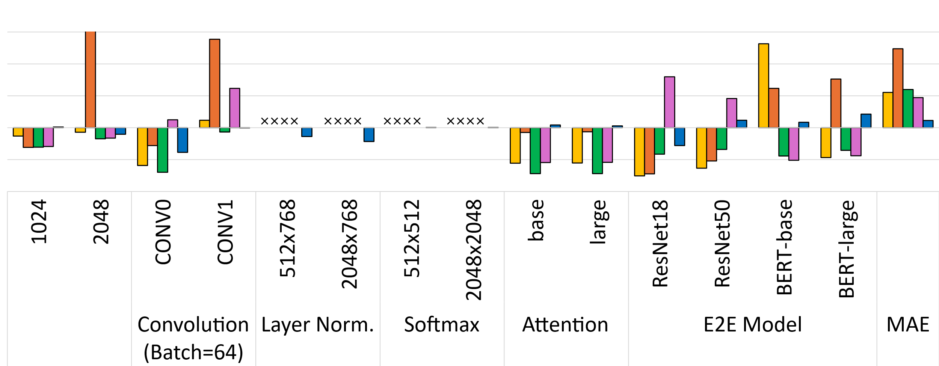
Evaluation: Validation against Real TPU v3
Relative Error
150%
860%
100%
124%
55%
60%
50%
47%
0%
Better
12%
-50%
-100%
PyTorchSim can accurately simulate full models end-to-end
GEMM
(NxNxN)
Notes:
This chart shows relative error of simulators compared to real TPU v3.
(click) Overall, PyTorchSim shows better accuracy compared to the other simulators with an average Mean Absolute Error of 12%.
(click) Also, our com’piler and full ISA support enable accurate modeling for vector operation.
(click) In contrast, the other simulators lack vector operation support, and as a result, underestimate the runtime for full models.
(click) PyTorchSim significantly improves simulation accuracy over the other simulators.

Slide 24
Evaluation: Speedup
Better
100
140
109
48
7.4x
10
9x
Speedup
1
0.1
PyTorchSim achieves significant simulation speedup
Notes:
Here, we show the simulation speedup of different simulators over Accel-sim baseline.
(click)PyTorchSim TLS achieves a 48(forty eight) times speedup.
(click) Thanks to our TLS, it achieves a 9x speedup compared to ILS.
(click) Also, when compared against mNPUSim, PyTorchSim TLS is still 7.4(seven point four) times faster.
(click) So, PyTorchsim enables faster simulation compared to the other cycle-accurate simulators.
(click)
2분

Slide 25
Contents
Background / Motivation
PyTorchSim
  Overview
  NPU core modeling
  Compiler workflow
Methodology & Evaluation
Case Studies (CS)
  Impact of DNN training hyperparameter
  Impact of data placement for chiplet-based NPUs
Summary
Notes:
Now, let’s look at two examples of case studies uniquely supported by PyTorchSim.
(click)

Slide 26
CS1: Impact of DNN Training Hyperparameter
MLP
Training loss
Norm.
NPU cycles
4.6x
PyTorchSim enables studying training time behaviors of systems
Notes:
This graph shows the training loss curve for a Multi Layer Perceptron,
(click) and per iteration cycle and total training cycle for two different batch sizes of 8, 128(one twenty eight).
As batch size increases, (click) the required epochs and (click) the per-iteration cycle increase.
(click) However, using the larger batch size reduces the number of iterations per epoch, resulting in a 4.6 times lower total training cycle.
(click) As this case study shows, PyTorchSim enables studying training time behaviors of systems through compiler support
(click)

Slide 27
CS2: Impact of Data Placement for Chiplet-based NPUs
Chiplet interconnect
(64 GB/s, 20 ns)
DRAM 0
(480 GB/s)
NPU
core 0
NPU
core 1
DRAM 1
(480 GB/s)
D2D
D2D
Local traffic
(High bandwidth)
Remote traffic
(Low bandwidth)
Notes:
The second case study shows the Impact of data placement for Chiplet-based NPUs (click) with constrained inter-chip bandwidth.
(click) so each core has two kinds of memory traffic — local traffic with high bandwidth, and remote traffic with low bandwidth
(click)

Slide 28
CS2: Impact of Data Placement for Chiplet-based NPUs
75%
Weight matrix
Local
DRAM 0
DRAM 1
25%
Remote
Local
Remote
Input matrix
Output matrix
Best mapping
(0,1)
NPU
core 1
(0,0)
NPU
core 0
NPU
core 0
DRAM 0
NPU
core 1
75%
DRAM 1
(1,0)
(1,1)
NPU
core 0
NPU
core 1
NPU
core 1
NPU
core 0
25%
Local
Remote
Worst mapping
Notes:
The input and weight matrices are equally split across the chiplets, but depending on data placement, The ratio of local to remote traffic varies.
(click) With this best mapping, each core generates three times more local memory traffic than remote traffic.
(click) With this worst mapping, we map the cores in the opposite way, resulting in the opposite ratio.
(click)

Slide 29
CS2: Impact of Data Placement for Chiplet-based NPUs
Norm. Runtime
3.4x
High remote traffic becomes the severe bottleneck
3.0x
Better
PyTorchSim enables the study of diverse NPU architectures
Notes:
This shows the performance of these two mappings and a monolithic NPU.
(click) As the amount of remote traffic increases, the runtime increases due to the constrained interchip bandwidth. The trend is aligned with the analytical results we discussed in our paper.
(click) Thus, PyTorchSim enables the study of diverse NPU architectures
(click)
2분

Slide 30
More Results and Discussions in the Paper
Case studies
Heterogeneous dense-sparse NPU
DNN inference with multi-model tenancy
Compiler optimization impact
Discussions
Extension for other deep learning frameworks
Extension for modeling GPUs and large-scale systems
Notes:
In addition, our paper includes additional results and discussions.
If you are interested in these, please check our paper
(click)

Slide 31
Summary
AI workloads require a comprehensive, fast, and accurate simulator
To address this, we propose PyTorchSim
  High-speed, high-accuracy through our Tile-Level Simulation (TLS)
  Integration with PyTorch 2 compilation flow
  General and extensible architecture through a RISC-V-based NPU ISA
Compared to prior NPU simulators, PyTorchSim:
  Enables various case studies not supported by prior simulators
  Significantly improves accuracy and simulation speed
Notes:
Now Let me summarize the talk.
(click) Fast-evolving AI workloads require a comprehensive, fast, and accurate simulator
(click) To address this, we propose PyTorchSim.
(click) it provides high-speed, high-accuracy simulation through our novel Tile-Level Simulation.
(click) And Integration with PyTorch 2 compilation flow allows users to simulate the full model for both training and inference without manual conversion
(click) Finally, PyTorchSim supports General and Extensible Architecture Modeling through a RISC-V-based NPU ISA.
(click) Compared to prior NPU simulators,
(click) PyTorchSim enables various case studies not supported by prior simulators
(click) And, most importantly, it significantly improves accuracy and simulation speed
(click)
1분

Slide 32
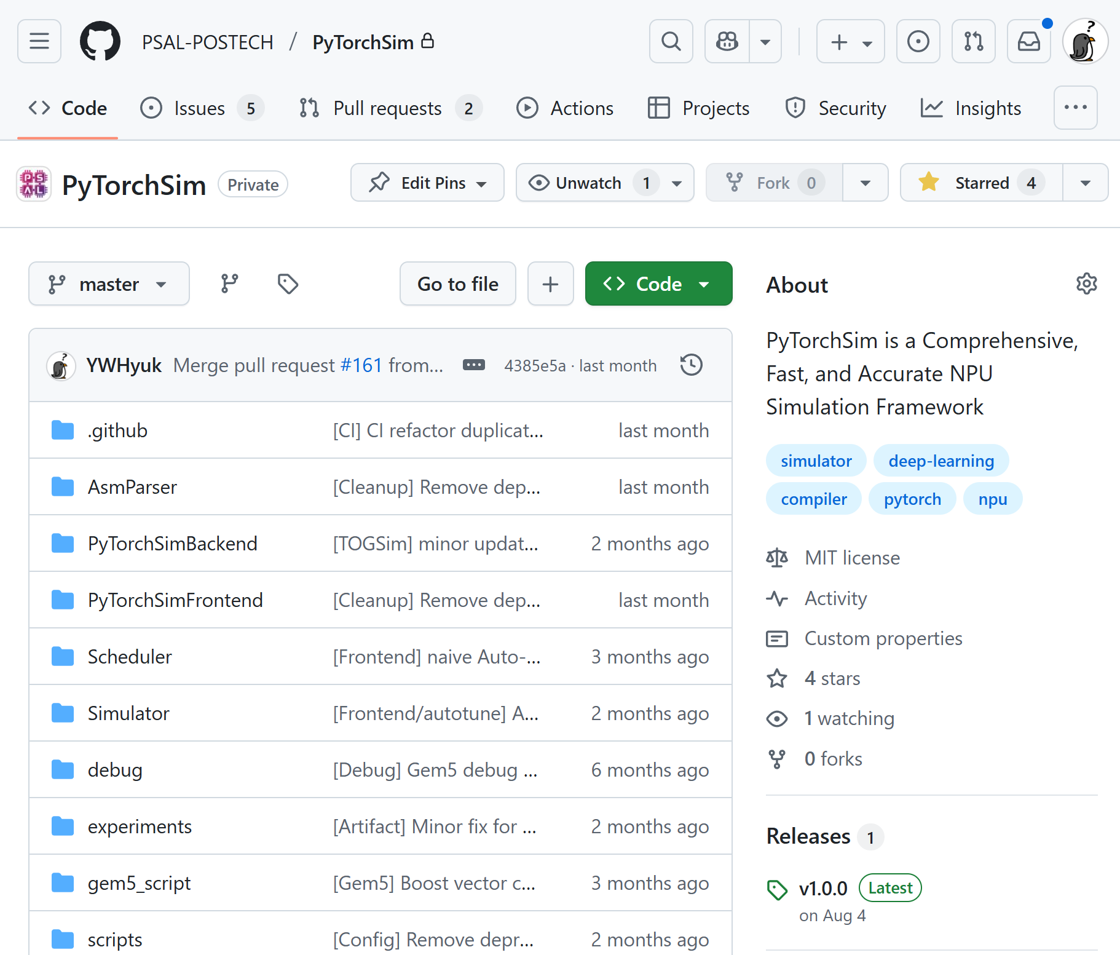
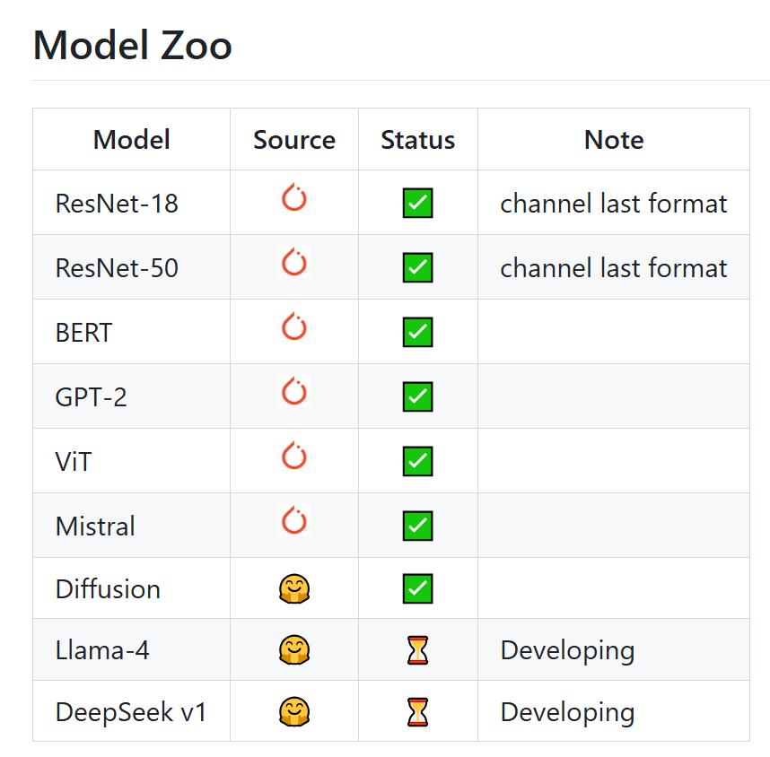

PyTorchSim is Open Source
Contributions are welcome!
GitHub Link
Notes:
PyTorchSim is open-source.
We are continuously working to support a wider range of models. Contributions are welcome.
You can find our repository by scanning the QR here.
Thank you. I'd be happy to take any questions.

Slide 33
Backup

Slide 34
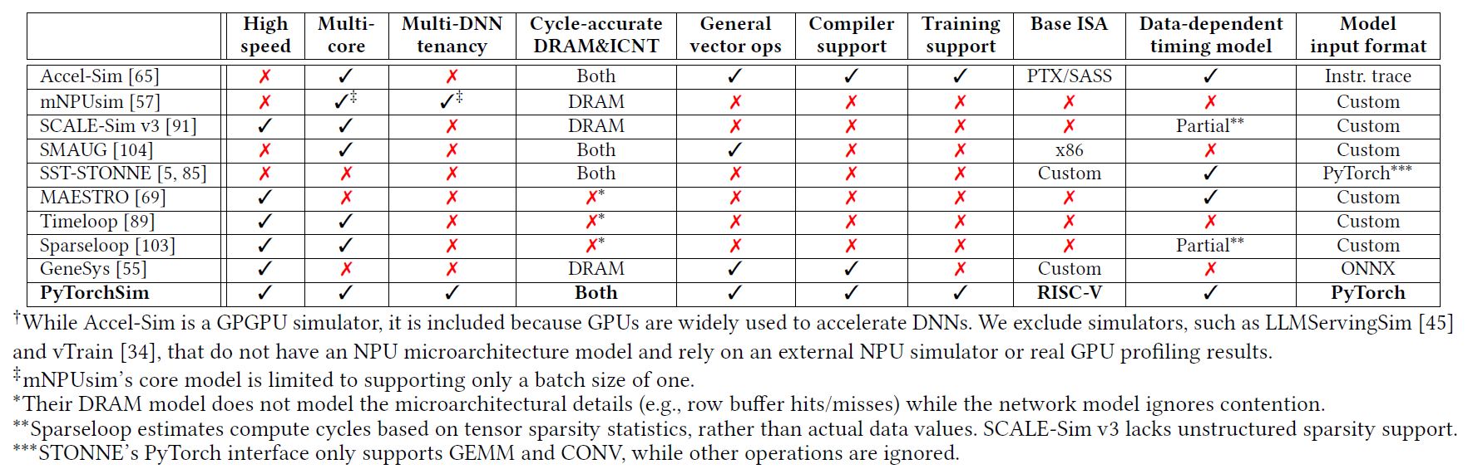
Comparison of the features of different NPU sim.

Slide 35
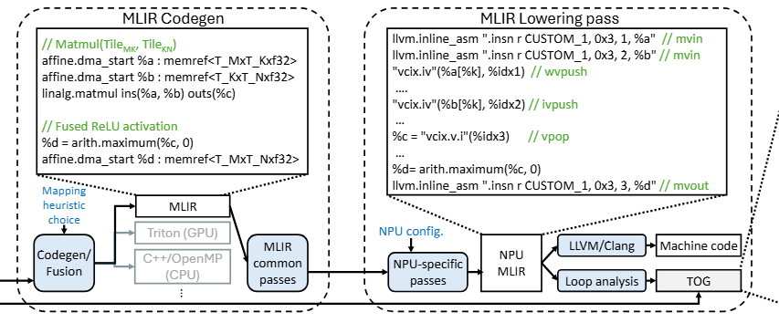
Compilation flow with simplified example IR
PyTorchSim backend generates MLIR code
  MLIR’s affine, arith, linalg, memref, vector, llvm, etc., which are widely used in AI compilers, are adopted to represent the LLIR.
Notes:
The MLIR dialects we use are widely adopted in projects like OpenXLA. Because of this, we can connect our framework to other ecosystems like TensorFlow by implementing the necessary lowering passes.

Slide 36
Tile Operation Graph
Tile Operation Graph (TOG)
Loop Start
DMA
Load Tile A
DMA
Load Tile B
Matrix Multiply
( X cycles )
Condition
DMA
Store Tile C
Notes:
You are right that there could be an overhead in using Spike to obtain these detailed attributes.
Since many kernels are composed of multiple loops—some of which are parallelizable—I thinke we can run this process in parallel across multiple CPU cores. In this way, we coulde effectively reduce much of the overhead.

Slide 37
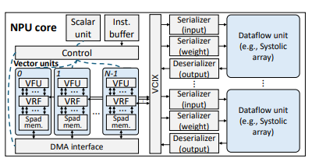
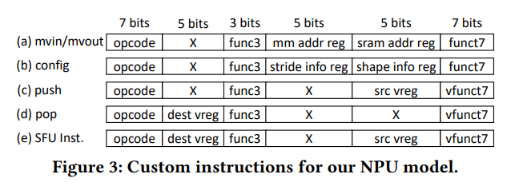
Custom Instructions
Notes:
Our custom DMA instructions are similar to those in Berkeley's Gemini, but we've extended them to support up to 4D tensors, which also take shape and stride as inputs

Slide 38
CS3: Heterogeneous Dense-Sparse NPU
NPU with third-party core
Mem. ctrl.
DRAM
Providing core abstraction interfaces
Sparse Core
(Ex. Flexagon)
···
···
Third-party core integration
Interconnect
Mem. ctrl.
DRAM
Notes:
Also, our simulator provides a core abstraction interface.
This enables third-party core integration, such as the Sparse Core shown here.

Slide 39
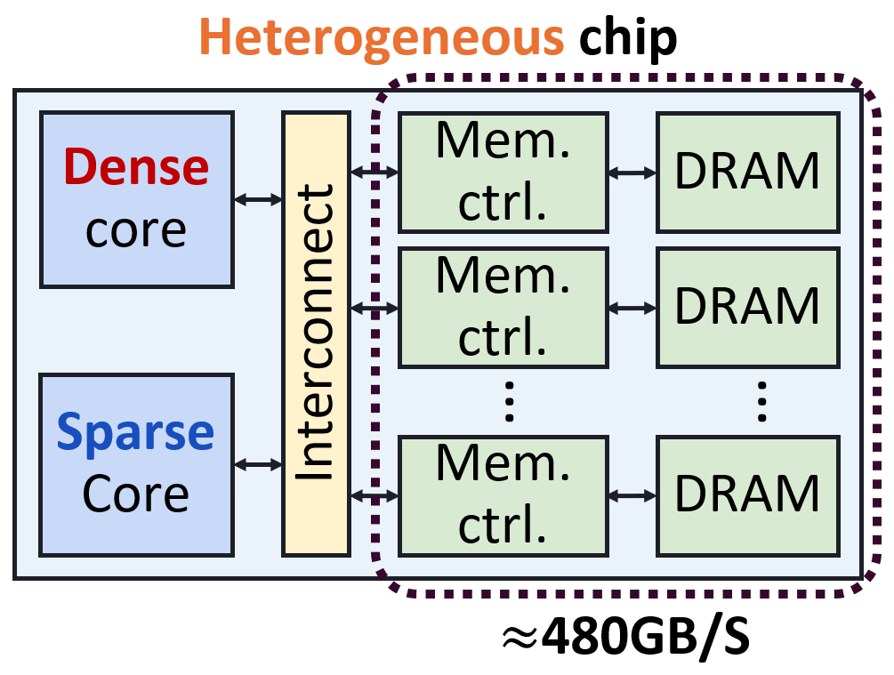
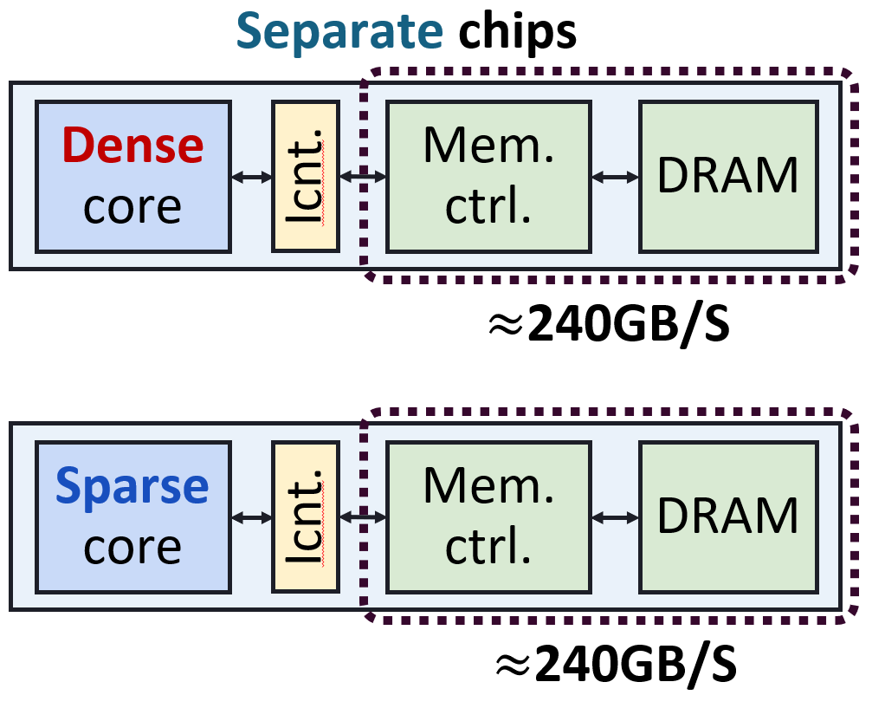
CS3: Heterogeneous Dense-Sparse NPU
Norm. Performance
Norm. Performance
Good
Good
+23%
-40%
Sparse core
(Sparse GEMM, 95% sparsity)
Sparse core
(Sparse GEMM, 95% sparsity)
Dense core
(Dense GEMM)
Dense core
(Dense GEMM)
Dense access patterns are favored
Takeaway: Memory scheduling must be carefully designed to ensure fairness
Notes:
As you can see, in the hetero system, the sparse core slows down, while the dense core speeds up
(click)
This is because the dense access patterns are favored under contention.
This shows that memory scheduler needs careful design—without fairness, the system becomes imbalanced
And PyTorchSim can model this effect, giving us a chance to evaluate scheduling
(click)
Training으로 대체

Slide 40
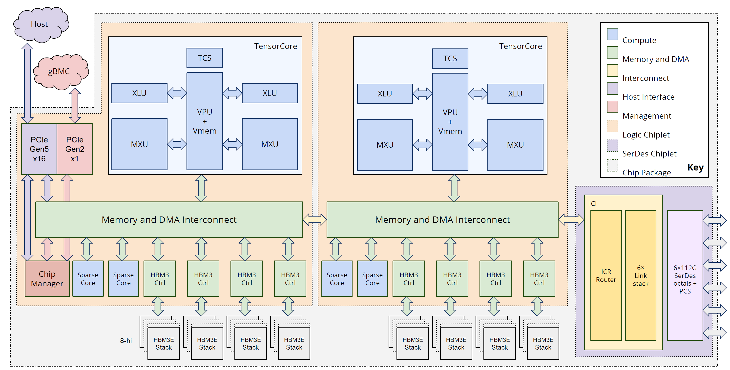
System-driven Requirements
Requirements for modern NPU architecture design
Vector Unit
Dataflow Unit
Interconnect
DRAM
Source: Source Hot Chips 2025, “Ironwood,” Aug 26, 2025, PDF (slide 15)
Notes:
NPU simulators should be able to accurately model many architectural elements.
(click)
For example, this is the TPU v7 architecture.
This architecture has (click) multi-core, (click) sparse core, (click) interconnect, (click) memory, (click) vector, (click) and dataflow units
To model these latest NPU designs,
(click)
Simulators should accurately model these architectural components
(click)

Slide 41
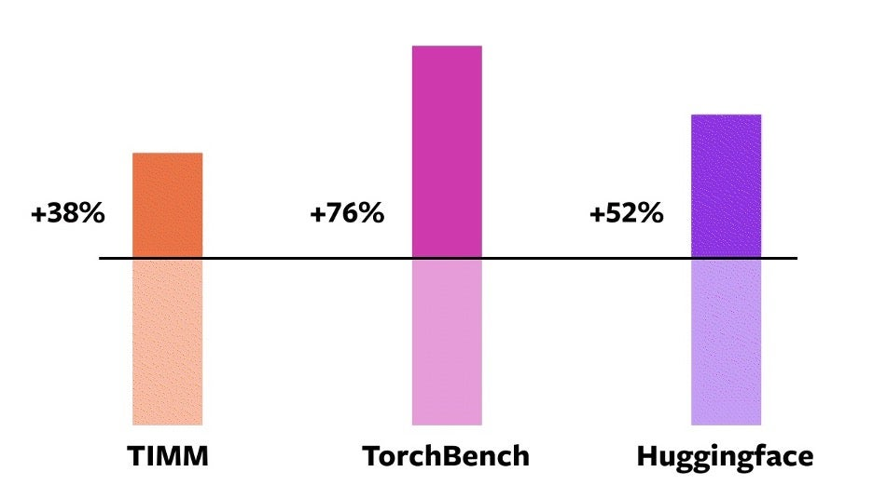
Why AI compiler support matters
Modern deep learning frameworks now integrate AI compilers
Compiler optimizations have a huge impact on hardware performance
torch.compile speedup over w/o compile on A100
+38%
+76%
+52%
Source: https://pytorch.org/get-started/pytorch-2-x/
Notes:
(click) Because modern deep learning such as tensorflow pytorch frameworks now integrate their own AI compilers.
(click) And this compiler optimization have a huge impact on hardware performance
(click) This graph shows the speedup with the PyTorch 2 compiler on an A100 GPU.
As you can see, performance improves significantly.
This demonstrates how heavily hardware performance relies on compiler optimizations.
(click)
Therefore, AI compiler support is not an option, but a necessity to accurately evaluate NPU performance.

Slide 42
Understanding Tile Operation Graph
GEMM + ReLU
B MATRIX
Tile Operation Graph (TOG)
Loop Start
Tile B
DMA
Load Tile A
DMA
Load Tile B
A MATRIX
C MATRIX
Matrix Multiply
Tile A
Tile C
Condition
Apply ReLU
Vector compute
Tile D
DMA
Store Tile D
D MATRIX

